Slide 1

1
/ 2
Data Science: Bank Marketing
October 2022

Slide 2
Executive Summary
The bank wishes to offer its term deposit product to clients, and before doing so, they want to create a model. The information is relevant to a financial institution's direct marketing initiatives. Phone calls were used in the marketing activities. More than one contact with the same consumer was frequently necessary in order to determine if the product (bank term deposit) will be subscribed to ('yes') or not ('no').

Slide 3
Problem Description
Bank wants amodel to shortlist consumers who are more likely to buy the product so that their marketing channels (telemarketing, SMS/email marketing, etc.) may focus exclusively on those customers who are more likely to buy the product.

Slide 4
Business Understanding
Bank wants to use ML model to shortlist consumers who are more likely to buy the product so that their marketing channel may focus exclusively on those customers who are more likely to buy the goods. This will save resource and their time ( which is directly involved in the cost ( resource billing)).

Slide 5
Task
Problem understanding
Data Understanding
Data Cleaning
Model Development
Model Selection
Model Evaluation
Report the accuracy, precision and recall of both the class of target variable
Explain the challenges and model selection

Slide 6
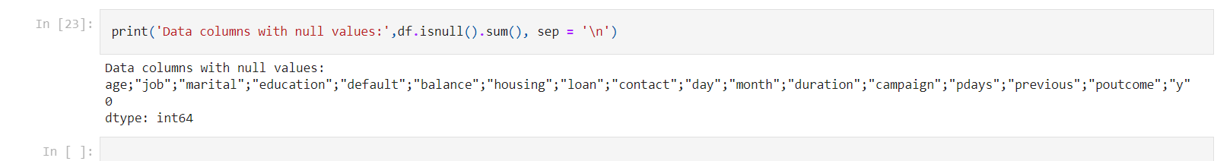
Missing Values
No missing values were found

Slide 7
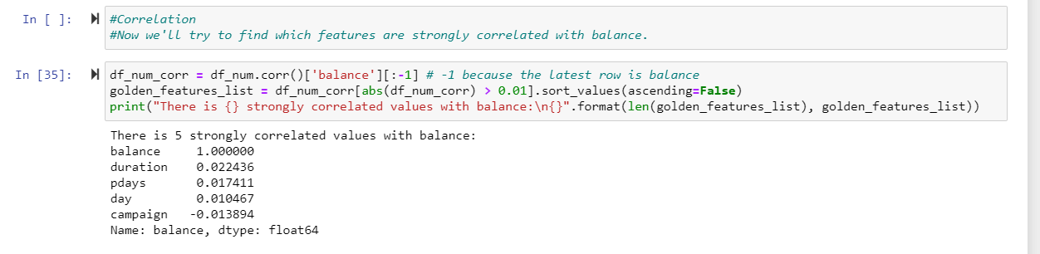
Correlation between features

Slide 8
Conclusion
We have found out that there is a strong correlation between values of «balanca», «duration» and «days» values.
Also, we can easily see how duration and balance values affect customers decisions. So, bank should focus on this areas.

Slide 9

Thank You

